Slide 1
Chapter 2 COMPUTER MEMORY

Slide 2
MAIN MEMORY
Every computer has a temporary storage built into the computer hardware
It stores instructions and data of a program mainly when the program is being executed by the CPU.
This temporary storage is known as main memory, primary storage, or simply memory.
Physically, it consists of some chips either on the motherboard or on a small circuit board attached to the motherboard of a computer
It has random access property.
It is volatile.

Slide 3
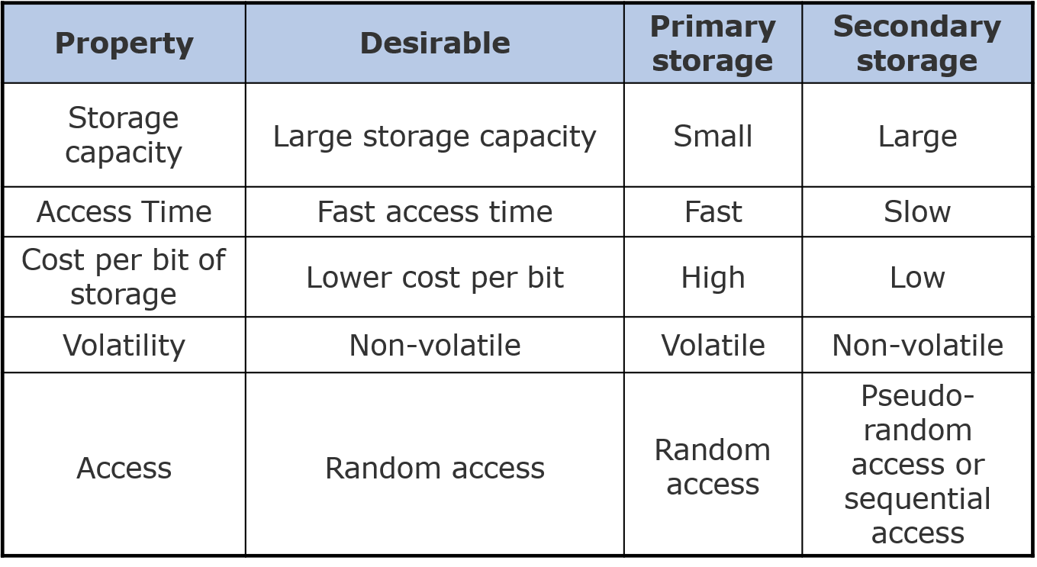
STORAGE EVALUATION CRITERIA

Slide 4
FIXED WORD LENGTH MEMORY
Word
0501
0502
0503
 |  | B | O | M | B | A | Y
 |  |  | D | E | L | H | I
Address Numbers
1024
Storage space is always allocated in multiples of word-length
Faster in speed of calculation than variable word-length memory
Normally used in large scientific computers for gaining speed of calculation

Slide 5
VERIABLE WORD-LENGTH MEMORY
0025
0026
B
O
M
B
A
Y
D
E
L
H
I
0051
Each memory location can store only a single character
Slower in speed of calculation than fixed world-length memory
Used in small business computers for optimizing the use of storage space
0052
0053
0054
0055
0056
0027
0028
0029
0030
Address Numbers
Address Numbers
0031
4096
4096
Note: With memory becoming cheaper and larger day-by-day, most modern computers employ fixed-word-length memory organization
5

Slide 6
MEMORY CAPACITY
Memory capacity of a computer is equal to the number of bytes that can be stored in its primary storage
Its units are:
Kilobytes (KB) : 1024 (2¹⁰) bytes
Megabytes (MB) : 1,048,576 (2²⁰) bytes
Gigabytes (GB) : 1,073,741824 (2³⁰) bytes

Slide 7
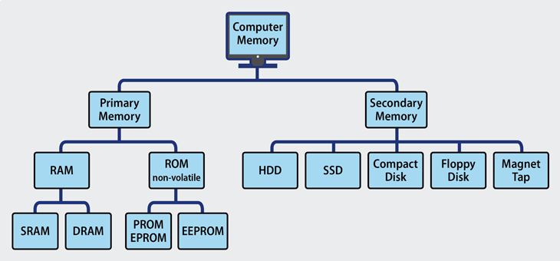
TYPES OF COMPUTER MEMORY

Slide 8
PRIMARY MEMORY

Slide 9
RANDOM ACCESS M EMORY (RAM)
Also called ‘main memory’
Implemented as ‘solid state’ (electronic) random access memory (RAM)
RAM is fast, small with low power consumption, but relatively expensive (cost per bit) and volatile (data is lost when switched off)
Like a CPU, it is build as an IC (integrated circuit)
How does RAM work?
https://www.youtube.com/watch?v=2CJcotBkf6w

Slide 10
RANDOM ACCESS M EMORY (RAM)
Two basic RAM technologies:
Static RAM (SRAM) – uses a flip-flop circuit and remembers as long as it has power but costs more
Dynamic RAM (DRAM) – uses a capacitor to hold charge, which leaks out so needs refreshing but costs less
Most PC systems (and games consoles etc) use dynamic RAM because of cost.

Slide 11
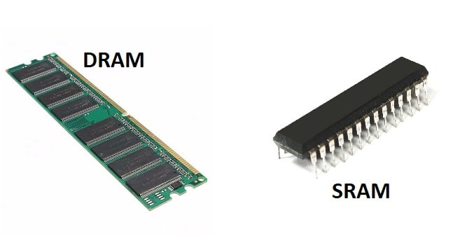
RANDOM ACCESS M EMORY (RAM)

Slide 12
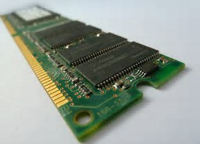
RANDOM ACCESS M EMORY (RAM)
Modern computers have multiple Gigabytes (GB) of RAM in a small number of chips mounted on a circuit board package called a ‘dual in-line memory module’ (DIMM) which mount in slots on the motherboard.
There is also ‘single in-line memory module’ (SIMM)

Slide 13
READ ONLY MEMORY (ROM)
ROM: Read Only Memory
Also known as ‘firmware’
A variation on the previous main memory
The data or program instructions are built into the chips when they are made and cannot be changed
Non-volatile – will retain data when power removed
Used for code that does not change, such as PC BIOS
http://computer.howstuffworks.com/rom.htm

Slide 14
TYPES OF ROM
Type | Usage
Manufacturer-programmed ROM | Data is burnt by the manufacturer of the electronic equipment in which it is used.
User-programmed ROM or Programmable ROM (PROM) | The user can load and store “read-only” programs and data in it
Erasable PROM (EPROM) | The user can erase information stored in it and the chip can be reprogrammed to store new information

Slide 15
TYPES OF ROM
Type | Usage
Ultra Violet EPROM (UVEPROM) | A type of EPROM chip in which the stored information is erased by exposing the chip for some time to ultra-violet light
Electrically EPROM (EEPROM) or Flash memory | A type of EPROM chip in which the stored information is erased by using high voltage electric pulses

Slide 16
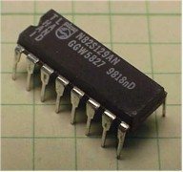
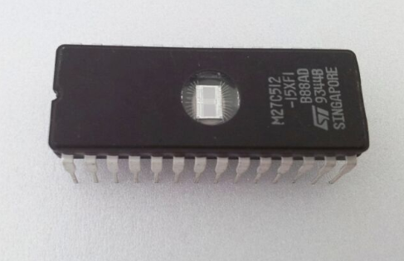
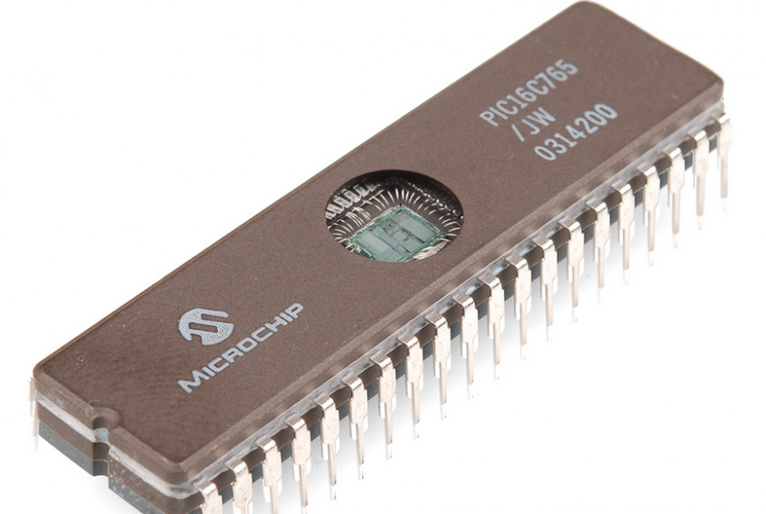
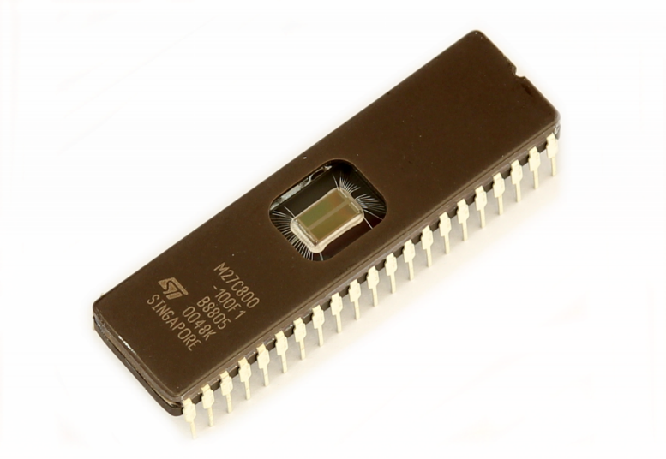
TYPES OF ROM
PROM
EPROM
EEPROM
UVEPROM

Slide 17
QUICK BRAIN – Sample Question 1
How does RAM work?
State the differences between SRAM & DRAM

Slide 18
SECONDARY MEMORY

Slide 19
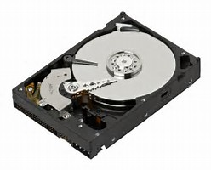
HARD DISK
Also called backing store - normally implemented as a hard-disk drive (HDD)
Non-volatile, low cost per bit, high power consumption, many times slower than RAM
Originally developed by IBM for mainframes - been massive advances in data storage density and overall capacity – even in laptops and desktops

Slide 20
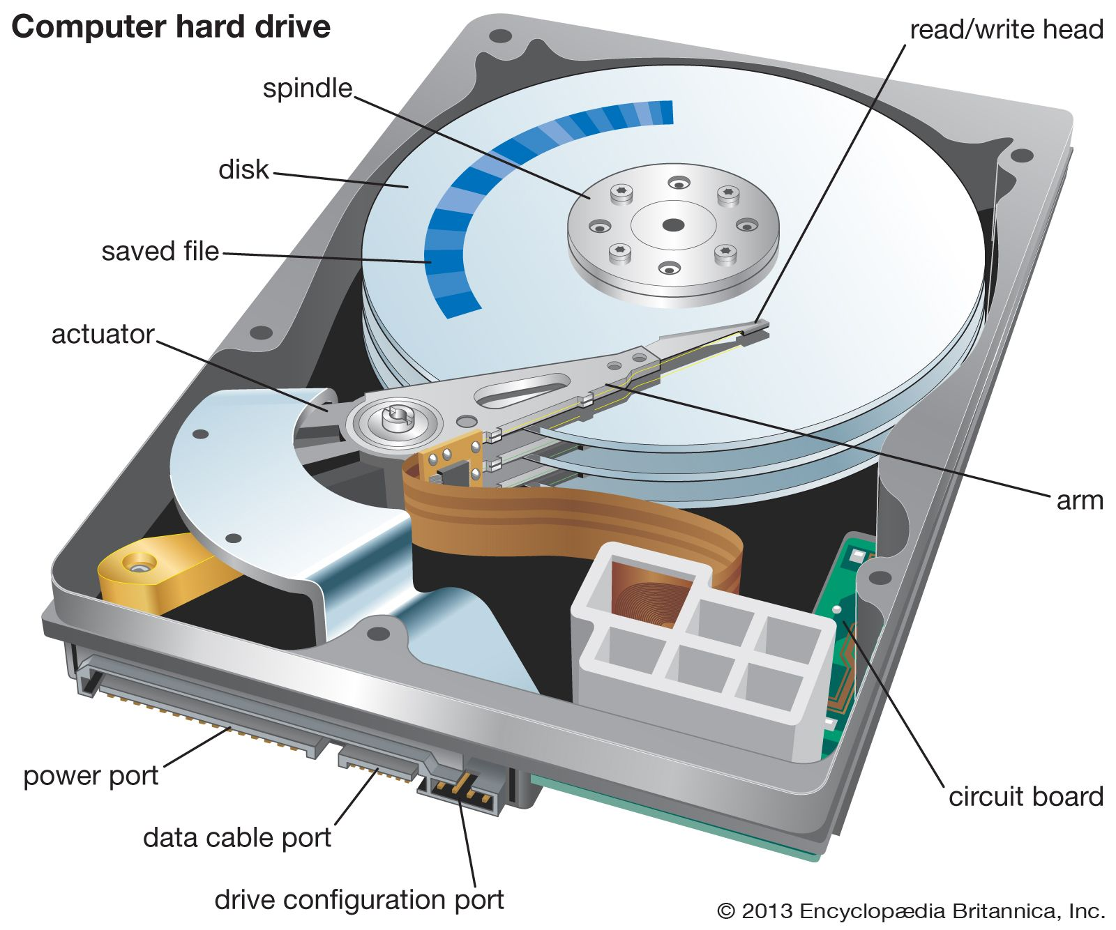
HARD DISK

Slide 21
HARD DISK
HDD capacity now multi-terabytes (TB)
Multiple ‘platters’ are held in a stack, coated with a magnetic material, and divided into sectors, tracks and clusters
These partitioned platter surfaces can be magnetised in two ways – giving binary storage
A read/write head hovers over the spinning disk surfaces and through electro-magnetism can detect (read) the values or record (write)new data
http://www.ntfs.com/hard-disk-basics.htm

Slide 22
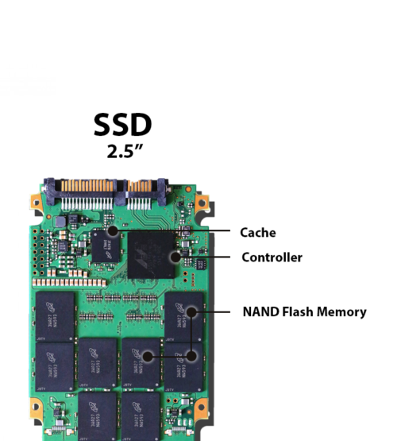
SOLID STATE DISK
SSD capacity multi-terabytes (TB)
Uses interconnected flash-memory chips, not magnetic media, to store data.
No moving parts, SSDs can deliver improved reliability.
Significant increase in the performance of a computer equipped with an SSD.
SSDs consume far less power than traditional hard drives.
https://computer.howstuffworks.com/solid-state-drive.htm

Slide 23
OPTICAL DISK
Originally based on Compact Disk (CD) technology from the music industry – have variations like CD-R
Then came Digital Versatile Disk (DVD) from the movie industry - due to higher data compression and thus storage capacity
Now we have Blu-ray disks
Hard disks (HDD) use spots of magnetism to store data
Optical disks use spots of light – as reflective disk surface stamped with “pits” and “lands”- giving a binary storage system - read by bouncing a laser off the surface and detecting changes in reflection from pits and lands
http://electronics.howstuffworks.com/cd.htm
http://electronics.howstuffworks.com/dvd.htm
http://electronics.howstuffworks.com/blu-ray.htm

Slide 24
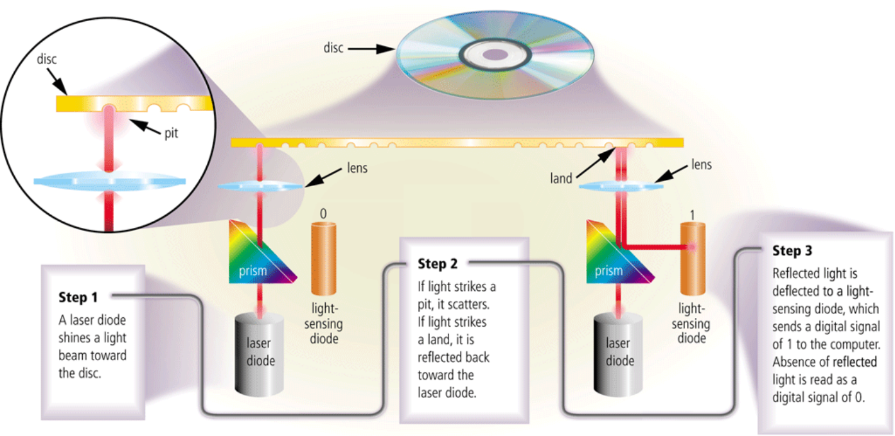
OPTICAL DISK

Slide 25
FLASH MEMORY
Use flash RAM technology as secondary storage
Common examples include USB memory stick and camera data cards
Should be regarded as temporary storage as they are less reliable long term than hard disk or optical storage
Subject to physical damage

Slide 26
PRIMARY VS SECONDARY MEMORY
Parameter | Primary memory | Secondary memory
Nature | The primary memory is categorized as volatile & nonvolatile memories. | The secondary memory is always a non-volatile memory.
Alias | These memories are also called internal memory. | Secondary memory is known as a Backup memory or Additional memory or Auxiliary memory.
Access | Data is directly accessed by the processing unit. | Data cannot be accessed directly by the processor. It is first copied from secondary memory to primary memory. Only then CPU can access it.
Formation | It's a volatile memory meaning data cannot be retained in case of power failure. | It's a non-volatile memory so that that data can be retained even after power failure.

Slide 27
CACHE MEMORY
It is commonly used for minimizing the memory- processor speed mismatch.
It is an extremely fast, small memory between CPU and main memory whose access time is closer to the processing speed of the CPU.
It is used to temporarily store very active data and instructions during processing.
Cache is pronounced as “cash”

Slide 28
QUICK BRAIN – Sample Question 2
What is secondary storage? What are the two types of secondary storage? Briefly explain
Why secondary storage is essential?

